Slide 1
Chapter 02
Instruction Set and Programming
1
21-Nov-2010
ohmshankar.ece@act.edu.in

Slide 2
2.1 Addressing Modes
2.2 Instruction set-Data Transfer Instructions, String Instructions, Logical Instructions, Arithmetic Instructions, Transfer of Control Instructions, Processor Control Instructions
2.3 Assembler Directives and Assembly Language Programming, Macros, Procedures

Slide 3
Addressing modes are important in assembly language programming as they define how data is located and accessed by instructions.
These modes describe how an instruction specifies its operands, whether they are immediate values, memory addresses, or registers.
They play important role in processor to fetch or store data for an operation, allowing us to manage read/write operations during program execution.
Effective use of addressing modes makes assembly language code more efficient and flexible, directly impacting performance.
What is Addressing Mode?
Addressing modes specify how an instruction identifies the data, or operands. It operates on in assembly language.
This field indicates whether the operand is a direct value, a memory address, or stored in a register.
Addressing modes are important during instruction execution, as they define the form of an operand and the way data is accessed, making sure proper data handling at the machine level

Slide 4
Types of addressing mode in 8086
Addressing modes help us to understand the types of operands and the way they are accessed while executing an instruction.
Immediate addressing mode
Direct addressing mode
Register addressing mode
Register Indirect addressing mode
Indexed addressing mode
Register relative addressing mode
Base plus index addressing mode
Base relative plus index addressing mode

Slide 5
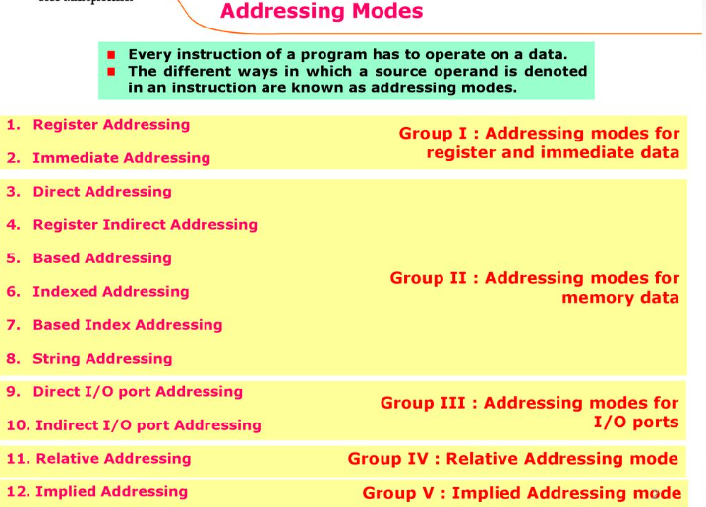

Slide 6
Types of Addressing Modes
Register Mode: In this type of addressing mode both the operands are registers.
Example:
MOV AX, BX (
XOR AX, DX
ADD AL, BL
Immediate Mode: In this type of addressing mode the source operand is a 8 bit or 16 bit data. Destination operand can never be immediate data.
Example:
MOV AX, 2000
MOV CL, 0A
ADD AL, 45
AND AX, 0000
Displacement or Direct Mode: In this type of addressing mode the effective address is directly given in the instruction as displacement.
Example:
MOV AX, [DISP]
MOV AX, [0500]
Register Indirect Mode: In this addressing mode the effective address is in SI, DI or BX.
Example: Physical Address = Segment Address + Effective Address
MOV AX, [DI]
ADD AL, [BX]
MOV AX, [SI]
copies the contents of the 16-bit BX register into the 16-bit AX register)
Suppose the register BX contains 4895H, then the contents ; 4895H are moved to AX

Slide 7
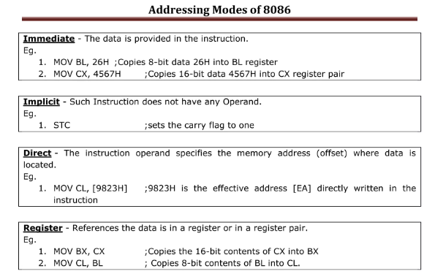

Slide 8
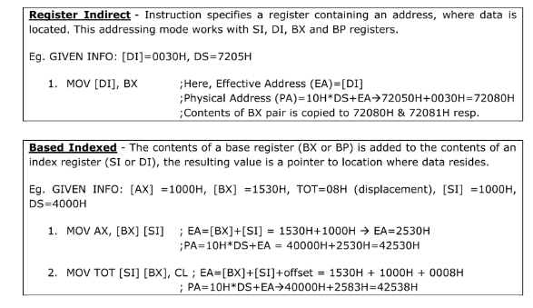

Slide 9
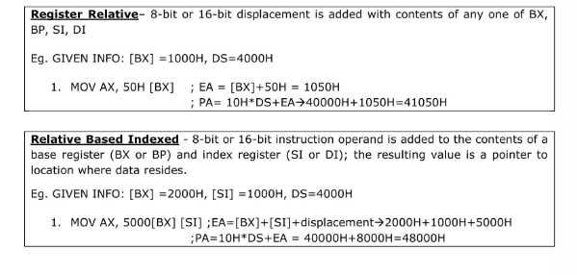

Slide 10
Based Indexed Mode: In this the effective address is sum of base register and index register.
Base register: BX, BP
Index register: SI, DI
Indexed Mode: In this type of addressing mode the effective address is sum of index register and displacement.
Example:
MOV AX, [SI+2000]
MOV AL, [DI+3000]
Based Mode: In this the effective address is the sum of base register and displacement.
Example:
MOV AL, [BP+ 0100]
Based Indexed Displacement Mode: In this type of addressing mode the effective address is the sum of index register, base register and displacement.
Example:
MOV AL, [SI+BP+2000]
String Mode: This addressing mode is related to string instructions. In this the value of SI and DI are auto incremented and decremented depending upon the value of directional flag.
Example:
MOVS B
MOVS W
Input/Output Mode: This addressing mode is related with input output operations.
Example:
IN A, 45
OUT A, 50
Relative Mode: In this the effective address is calculated with reference to instruction pointer.
Example:
JNZ 8 bit address
IP=IP+8 bit address

Slide 11
Instruction Set of 8086
An instruction is a binary pattern designed inside a microprocessor to perform a specific function.
The entire group of instructions that a microprocessor supports is called Instruction Set.
8086 has more than 20,000 instructions.
11
ohmshankar.ece@act.edu.in
21-Nov-2010

Slide 12
Classification of Instruction Set
1. Arithmetic Instructions and Logical Instruction
2. Data Transfer Instructions
3. Branch and Loop Instruction
4. M/C control Instruction
5. Flag Manipulation Instructions
6. Shift and Rotate Instruction
7. String Instructions
12

Slide 13
1. Arithmetic And Logical Instructions
Arithmetic Instructions are the instructions which perform basic arithmetic operations such as addition, subtraction and a few more. Unlike in 8085 microprocessor, in 8086 microprocessor the destination operand need not be the accumulator.
The processor supports the following data sizes −
Bit: A binary digit that can be either 0 or 1. In a hardware computer, a bit can be represented by a voltage level. In a virtual computer, a bit can represent a Boolean value, such as true or false.
Byte: A sequence of eight bits.
Word: A sequence of 16, 32, or 64 bits, depending on the computer. A word is usually made up of two bytes.
Word: a 2-byte data item
Doubleword: a 4-byte (32 bit) data item
Quadword: an 8-byte (64 bit) data item
Paragraph: a 16-byte (128 bit) area
Kilobyte: 1024 bytes
Megabyte: 1,048,576 bytes

Slide 14
Arithmetic Instructions
ADD Des, Src:
  It adds a byte to byte or a word to word.
  It effects AF, CF, OF, PF, SF, ZF flags.
  E.g.:
    ADD AL, 74H
    ADD DX, AX
    ADD AX, [BX]
ADC Des, Src:
  It adds the two operands with CF.
  It effects AF, CF, OF, PF, SF, ZF flags.
  E.g.:
    ADC AL, 74H
    ADC DX, AX
    ADC AX, [BX]
14

Slide 15
Arithmetic Instructions
SUB Des, Src:
  It subtracts a byte from byte or a word from word.
  It effects AF, CF, OF, PF, SF, ZF flags.
  For subtraction, CF acts as borrow flag.
  E.g.:
    SUB AL, 74H
    SUB DX, AX
    SUB AX, [BX]
SBB Des, Src:
  It subtracts the two operands and also the borrow from the result.
  It effects AF, CF, OF, PF, SF, ZF flags.
  E.g.:
    SBB AL, 74H
    SBB DX, AX
    SBB AX, [BX]
15

Slide 16
Arithmetic Instructions
MUL Src:
  It is an unsigned multiplication instruction.
  It multiplies two bytes to produce a word or two words to produce a double word.
  AX = AL * Src
  DX : AX = AX * Src
  This instruction assumes one of the operand in AL or AX.
  Src can be a register or memory location. And Flags-OF, CF
  Unused bits of destination register is always filled with sign bit
IMUL Src:
  It is a signed multiplication instruction.
16

Slide 17
Arithmetic Instructions
DIV Src:
  It is an unsigned division instruction.
  It divides word by byte or double word by word.
  The operand is stored in AX, divisor is Src and the result is stored as:
    AH = remainder, AL = quotient (for word/byte)
    DX=remainder, AX=quotient (for D-word/word)
IDIV Src:
  It is a signed division instruction.
17

Slide 18
Arithmetic Instructions
CBW (Convert Byte to Word):
  This instruction converts byte in AL to word in AX.
  The conversion is done by extending the sign bit of AL throughout AH.
CWD (Convert Word to Double Word):
  This instruction converts word in AX to double word in DX : AX.
  The conversion is done by extending the sign bit of AX throughout DX.
18

Slide 19
Arithmetic Instructions
INC Src:
  It increments the byte or word by one.
  The operand can be a register or memory location.
  E.g.: INC AX
  INC [SI]
DEC Src:
  It decrements the byte or word by one.
  The operand can be a register or memory location.
  E.g.: DEC AX
DEC [SI]
19

Slide 20
Arithmetic Instructions
CMP Des, Src:
  It compares two specified bytes or words.
  The Src and Des can be a constant, register or memory location.
  Both operands cannot be a memory location at the same time.
  The comparison is done simply by internally subtracting the source from destination.
  The value of source and destination does not change, but the flags CF, ZF, SF are modified to indicate the result.
20

Slide 21
Arithmetic Instructions
DAA (Decimal Adjust after Addition)
  It is used to make sure that the result of adding two BCD numbers is adjusted to be a correct BCD number.
  It only works on AL register.
For Subtraction : DAS (Decimal Adjust after Subtraction)
AAA (ASCII Adjust after Addition):
  This Instruction Can be used to convert the contents of the AL register to unpacked BCD result
  i.e. If lower nibble of AL>9 then
  1. AL=AL+6 2. AH=AH+1
  3. AL=AL AND 0FH
  This instruction does not have any operand.
Other ASCII Instructions:
  AAS (ASCII Adjust after Subtraction)
  AAM (ASCII Adjust after Multiplication)
  AAD (ASCII Adjust Before Division)
21

Slide 22
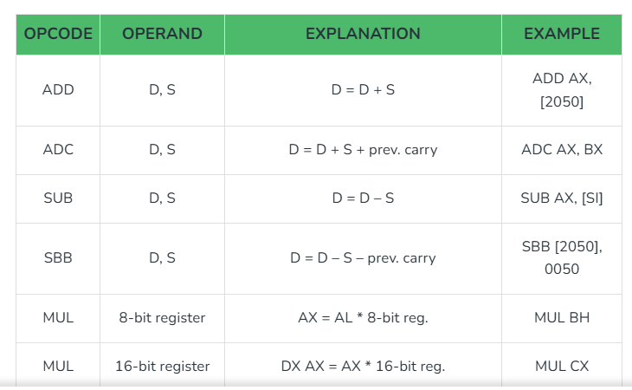
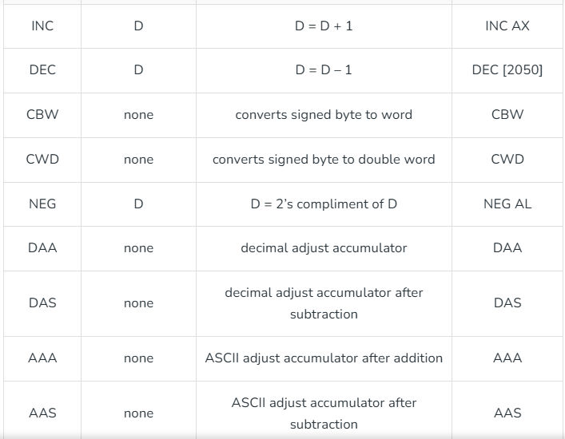
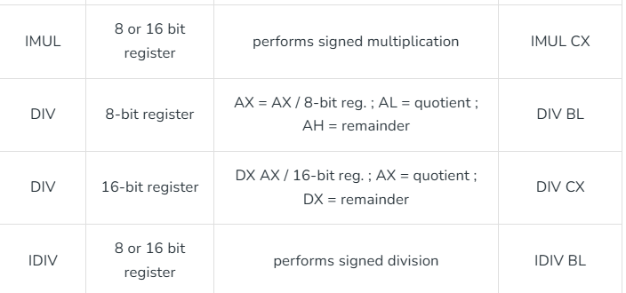
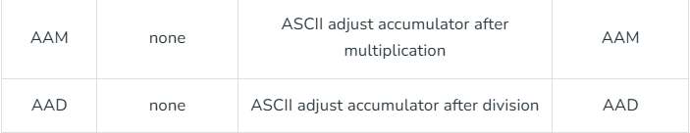
Here D stands for destination and S stands for source.
D and S can either be register, data or memory address.

Slide 23
Logical Instructions
AND Des, Src:
  It performs AND operation of Des and Src.
  Src can be immediate number, register or memory location.
  Des can be register or memory location.
  Both operands cannot be memory locations at the same time.
  CF and OF become zero after the operation.
  PF, SF and ZF are updated.
NOT Src:
  It complements each bit of Src to produce 1’s complement of the specified operand.
  The operand can be a register or memory location.
  e,.g NOT AX
23

Slide 24
Bit Manipulation Instructions
OR Des, Src:
  It performs OR operation of Des and Src.
  Src can be immediate number, register or memory location.
  Des can be register or memory location.
  Both operands cannot be memory locations at the same time.
  CF and OF become zero after the operation.
  PF, SF and ZF are updated.
XOR Des, Src:
  It performs XOR operation of Des and Src.
  Src can be immediate number, register or memory location.
  Des can be register or memory location.
  Both operands cannot be memory locations at the same time.
  CF and OF become zero after the operation.
  PF, SF and ZF are updated.
24

Slide 25
Bit Manipulation Instructions
TEST Des, Src:
  It performs AND operation of Des and Src.
  Src can be immediate number, and src/Des can be register or memory location.
  It is Non-Destructive And means Dest is not modified only flags are affected.
  Both operands cannot be memory locations at the same time.
  CF and OF become zero after the operation.
  PF, SF and ZF are updated.
25

Slide 26
2. Data Transfer Instructions
Data transfer instructions in the 8086 microprocessor are used to move data between memory locations, registers, and input/output (I/O) devices. These instructions are essential for manipulating data within a program, as well as for communicating with external devices.
Types of Data transfer instructions :
2. Load instructions:
These instructions are used to load data from a memory location or I/O device into a register. They include the following instructions:
LDS: Loads a 16-bit pointer value from a memory location into a register pair and loads the 8-bit value from the next memory location into another register.
LSS: Loads a 16-bit pointer value from a memory location into a register pair and loads the 16-bit value from the next memory location into another register.
LXI: Loads a 16-bit value into a register pair.
MOV with memory operand: Loads data from a memory location into a register.
1. Move instructions:
These instructions are used to move data from one memory location to another or between a memory location and a register. They include the following instructions:
MOV: Moves data from a source operand to a destination operand.
XCHG: Swaps the contents of two operands.
XLAT: Translates a byte in memory using a lookup table pointed to by the contents of the AL register.
LEA: Loads a 16-bit offset address into a register.
26

Slide 27
Data Transfer Instructions
MOV Des, Src:
  It is used to copy the content of Src to Des
  Src operand can be register, memory location or immediate operand.
  Des can be register or memory operand.
  Both Src and Des cannot be memory location at the same time.
  E.g.:
    MOV CX, 037A H
    MOV AL, BL
    MOV BX, [0301 H]
27

Slide 28
Data Transfer Instructions
PUSH Operand:
  It pushes the operand into top of stack.
  E.g.: PUSH BX
POP Des:
  It pops the operand from top of stack to Des.
  Des can be a general purpose register, segment register (except CS) or memory location.
  E.g.: POP AX
28

Slide 29
Data Transfer Instructions
XCHG Des, Src:
  This instruction exchanges Src with Des.
  It cannot exchange two memory locations directly.
  E.g.: XCHG DX, AX
29

Slide 30
Data Transfer Instructions
IN Accumulator, Port Address:
  It transfers the operand from specified port to accumulator register.
  E.g.: IN AX, 0028 H
OUT Port Address, Accumulator:
  It transfers the operand from accumulator to specified port.
  E.g.: OUT 0028 H, AX
30

Slide 31
Data Transfer Instructions
LEA Register, Src:
  It loads a 16-bit register with the offset address of the data specified by the Src.
  E.g.: LEA BX, [DI]
    This instruction loads the contents of DI (offset) into the BX register.
31

Slide 32
Data Transfer Instructions
LDS Des, Src:
  It loads 32-bit pointer from memory source to destination register and DS.
  The word is placed in the destination register and the segment is placed in DS.
  This instruction Copies the word at the lower memory address to the Des reg and the word at the higher address to the segment reg i.e. DS.
  E.g.: LDS BX, [0301 H]
32

Slide 33
Data Transfer Instructions
LES Des, Src:
  It loads 32-bit pointer from memory source to destination register and ES.
  The Word is placed in the destination register and the segment is placed in ES.
  This instruction is very similar to LDS except that it initializes ES instead of DS.
  E.g.: LES BX, [0301 H]
33

Slide 34
Data Transfer Instructions
LAHF:
  It copies the lower byte of flag register to AH.
SAHF:
  It copies the contents of AH to lower byte of flag register.
PUSHF:
  Pushes flag register to top of stack.
POPF:
  Pops the stack top to flag register.
34

Slide 35
3. Branch/Program Execution Transfer Instructions
These instructions cause change in the sequence of the execution of instruction.
This change can be a conditional or sometimes unconditional.
The conditions are represented by flags.
35

Slide 36
Branch Instructions
CALL Des:
  This instruction is used to call a subroutine or function or procedure.
  The address of next instruction after CALL is saved onto stack.
RET:
  It returns the control from procedure to calling program.
  Every CALL instruction should have a RET.
36

Slide 37
Branch Instructions
JMP Des:
  This instruction is used for unconditional jump from one place to another.
Jxx Des (Conditional Jump):
  All the conditional jumps follow some conditional statements or any instruction that affects the flag.
37

Slide 38
Conditional Jump Table
Mnemonic | Meaning | Jump Condition
JA | Jump if Above | CF = 0 and ZF = 0
JAE | Jump if Above or Equal | CF = 0
JB | Jump if Below | CF = 1
JBE | Jump if Below or Equal | CF = 1 or ZF = 1
JC | Jump if Carry | CF = 1
JE | Jump if Equal | ZF = 1
JNC | Jump if Not Carry | CF = 0
JNE | Jump if Not Equal | ZF = 0
JNZ | Jump if Not Zero | ZF = 0
JPE | Jump if Parity Even | PF = 1
JPO | Jump if Parity Odd | PF = 0
JZ | Jump if Zero | ZF = 1
38

Slide 39
Loop Instructions
Loop Des:
  This is a looping instruction.
  The number of times looping is required is placed in the CX register.
  With each iteration, the contents of CX are decremented.
  ZF is checked whether to loop again or not.
39

Slide 40
Program Execution Transfer Instructions
INTO (Interrupt on overflow):
This instruction generates type 4 interrupt (i.e. interrupt for overflow) and causes the 8086 to do an indirect far call a procedure which is written by the user to handle the overflow condition.
IRET
To return the execution to the interrupted program
40

Slide 41
4. Machine Control Instructions

Slide 42
Machine Control Instructions
HLT (Halt) :- It causes the processor to enter in to the halt state. It can be stop by INTR,NMI or RESET pin
NOP (No Opration) :- It causes the processor to enter in to the wait state for 3 Clock cycles.
WAIT :- It causes the processor to enter in to the ideal state. Can be stop by TEST, INTR OR NMI pin
LOCK :- This instruction prevents other processors to take the control of shared resources. For e.g LOCK IN AL,80H
21-Nov-2010
ohmshankar.ece@act.edu.in
42

Slide 43
5. Flag Manipulation Instructions

Slide 44
Flag Manipulation Instructions
STC:
  It sets the carry flag to 1.
CLC:
  It clears the carry flag to 0.
CMC:
  It complements the carry flag.
44

Slide 45
Flag Manipulation Instructions
STD:
  It sets the direction flag to 1.
  If it is set, string bytes are accessed from higher memory address to lower memory address.
CLD:
  It clears the direction flag to 0.
  If it is reset, the string bytes are accessed from lower memory address to higher memory address.
45

Slide 46
Flag Manipulation Instructions
STI:
  It sets the Interrupt flag to 1.
CLI:
  It clears the Interrupt flag to 0.
21-Nov-2010
ohmshankar.ece@act.edu.in
46

Slide 47
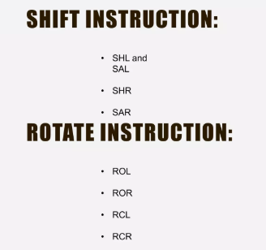
6. Shift And Rotate Instructions

Slide 48
Shift Instructions
Shift instructions: Shift instructions can perform two basic types of shift operations; the logical shift and the arithmetic shift. Also, each of these operations can be performed to the right or to the left.
SHL/SAL Des, Count:
  It shift bits of byte or word left, by count.
  It puts zero(s) in LSBs.
  MSB is shifted into carry flag.
  If the number of bits desired to be shifted is 1, then the immediate number 1 can be written in Count.
  However, if the number of bits to be shifted is more than 1, then the count is put in CL register. And recent bit to the CF (Carry flag)
SHR/SAR Des, Count:
  It shift bits of byte or word right, by count.
  It puts zero(s)(for SHL) and Sign bit (for SAL) in MSBs.
  LSB is shifted into carry flag.
  If the number of bits desired to be shifted is 1, then the immediate number 1 can be written in Count.
  However, if the number of bits to be shifted is more than 1, then the count is put in CL register. And recent bit to the CF (Carry flag)
48

Slide 49
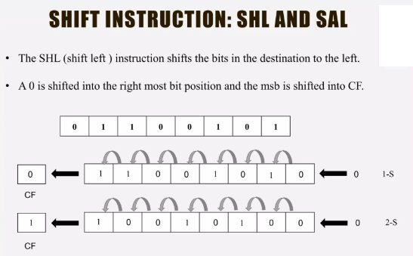
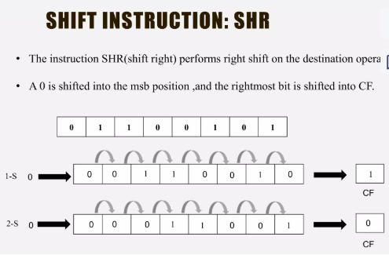
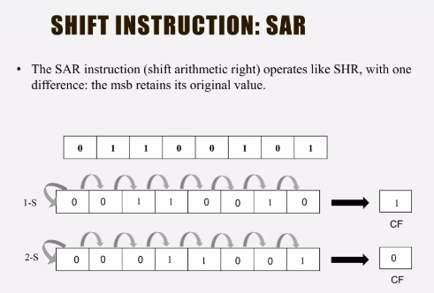

Slide 50
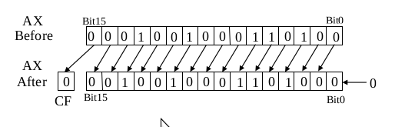
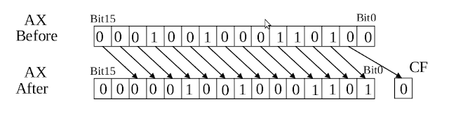
SHL, SHR, SAL, and, SAR instructions: The operation of these instructions is described in figure
As an example if (AX)=1234H, Executing SHL AX,1 can be illustrated as shown below:
The l6-bit contents of the AX register are shifted 1 bit position to the left. The vacated LSB location is filled with zero and the bit shifted out of the MSB is saved in CF.
If the source operand is specified as CL instead of 1, the count in this register represents the number of bit positions the contents of the operand are to be shifted. An example of executing SHR AX, CL FOR (AX=1234H) and CL=2 is shown below::
In an arithmetic shift to the left, the SAL operation, the vacated bits at the right of the operand are filled with zeros, whereas in an arithmetic shift to the right, the SAR operation, the vacated bits at the left are filled with the value of the original MSB of the operand.

Slide 51
Rotate Instructions
ROL Des, Count:
  It rotates bits of byte or word left, by count.
  LSB is transferred to MSB and also to CF.
  If the number of bits desired to be shifted is 1, then the immediate number 1 can be written in Count.
  However, if the number of bits to be shifted is more than 1, then the count is put in CL register. And recent bit to the CF (Carry flag)
ROR Des, Count:
  It rotates bits of byte or word right, by count.
  MSB is transferred to LSB and also to CF.
  If the number of bits desired to be shifted is 1, then the immediate number 1 can be written in Count.
  However, if the number of bits to be shifted is more than 1, then the count is put in CL register. And recent bit to the CF (Carry flag)
51

Slide 52
Rotate Instructions
RCL Des, Count:
  It rotates bits of byte or word right, by count.
  LSB to MSB then MSB is transferred to CF and CF to LSB.
  If the number of bits desired to be shifted is 1, then the immediate number 1 can be written in Count.
  However, if the number of bits to be shifted is more than 1, then the count is put in CL register. And recent bit to the CF (Carry flag)
RCR Des, Count:
  It rotates bits of byte or word left, by count.
  MSB to LSB then LSB is transferred to CF and CF to MSB.
  If the number of bits desired to be shifted is 1, then the immediate number 1 can be written in Count.
  However, if the number of bits to be shifted is more than 1, then the count is put in CL register. And recent bit to the CF (Carry flag)
52

Slide 53
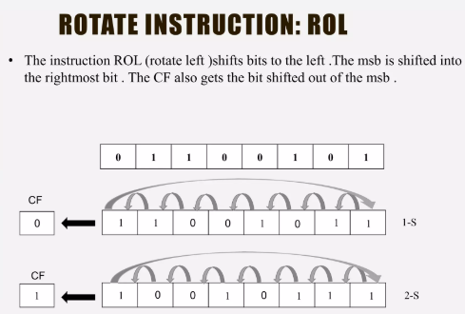
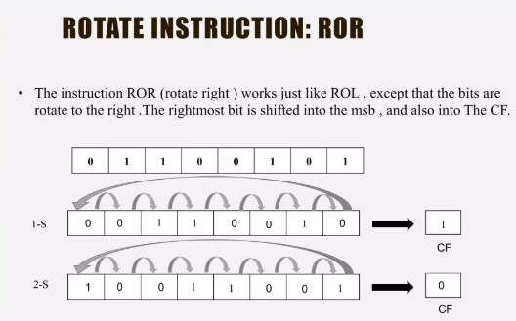
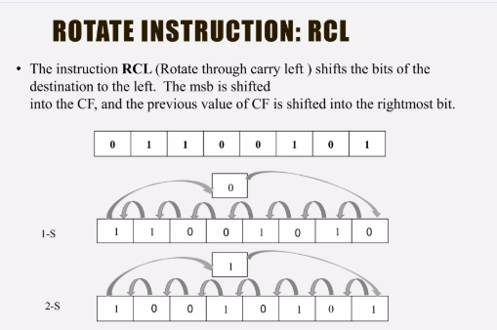
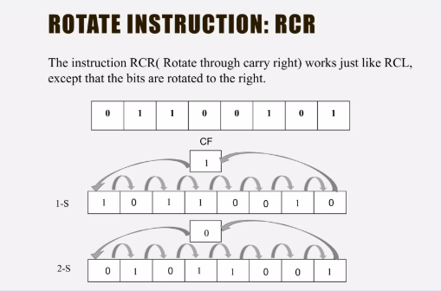

Slide 54
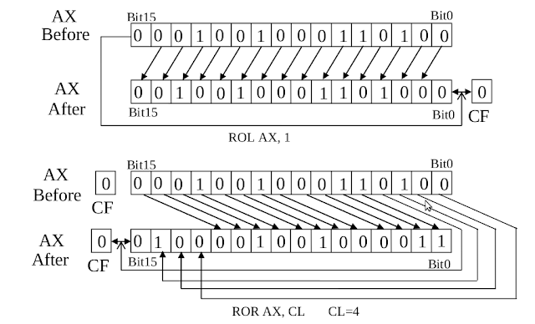
ROL, ROR, RCL, and, RCR instructions: They have the ability to rotate the contents of either an internal register or a storage location in memory. Also, the rotation that takes place can be from 1 to 255 bit positions to the left or to the right. Moreover, in the case of a multibit rotate, the number of bit positions to be rotated is specified by the value in CL.
If (CL) =02H and AX=1234AH . Determine the new contents of AX and the carry flag after executing the instructions:
a) ROL AX, 1 b) ROR AX, CL

Slide 55
7. String Manipulation Instructions

Slide 56
String Manipulation Instructions
String in assembly language is just a sequentially stored bytes or words.
There are very strong set of string instructions in 8086.
By using these string instructions, the size of the program is considerably reduced.
56

Slide 57
8086 Microprocessor
String Manipulation Instructions
String : Sequence of bytes or words
8086 instruction set includes instruction for string movement, comparison, scan, load and store.
REP instruction prefix : used to repeat execution of string instructions
String instructions end with S or SB or SW. S represents string, SB string byte and SW string word.
Offset or effective address of the source operand is stored in SI register and that of the destination operand is stored in DI register.
Depending on the status of DF, SI and DI registers are automatically updated.
DF = 0 ⇒ SI and DI are incremented by 1 for byte and 2 for word.
DF = 1 ⇒ SI and DI are decremented by 1 for byte and 2 for word.
57
Notes:
57

Slide 58
String Manipulation Instructions
MOVS / MOVSB / MOVSW:
  It causes moving of byte or word from one string to another.
  In this instruction, the source string is in Data Segment referred by DS:SI and destination string is in Extra Segment referred by ES:DI.
  For e.g. movs str1,str2
  Movsb
  Movsw
58

Slide 59
String Manipulation Instructions
LODS / LODSB / LODSW:
  It causes TRANSFER of byte or word from one string to another.
  In this instruction, the source string is in Data Segment referred by DS:SI transferred to Accumulator.
  For e.g. lods string
  lodsb
  lodsw
59

Slide 60
String Manipulation Instructions
STOS / STOSB / STOSW:
It causes TRANSFER of byte or word from one string to another.
In this instruction, the string is in Extra Segment referred by ES:DI transferred to Accumulator.
  For e.g. stos string
  stosb
  stosw
60

Slide 61
String Manipulation Instructions
CMPS Des, Src:
  It compares the string bytes or words.
SCAS String:
  It scans a string.
  It compares the String with byte in AL or with word in AX.
61

Slide 62
String Manipulation Instructions
REP (Repeat):
  This is an instruction prefix.
  It causes the repetition of the instruction until CX becomes zero.
  E.g.: REP MOVSB
    It copies byte by byte contents.
    REP repeats the operation MOVSB until CX becomes zero.
62

Slide 63
8086 Microprocessor
String Manipulation Instructions
REP REPZ/ REPE (Repeat CMPS or SCAS until ZF = 0) REPNZ/ REPNE (Repeat CMPS or SCAS until ZF = 1) | While CX ≠ 0 and ZF = 1, repeat execution of string instruction and (CX) ← (CX) – 1 While CX ≠ 0 and ZF = 0, repeat execution of string instruction and (CX) ← (CX) - 1
63
Notes:
63

Slide 64
Assembler Directives and Assembly Language Programming, Macros, Procedures

Slide 65
8086- Assembler directives
Assembler directives are the directions to the assembler which indicate how an operand or section of the program is to be processed. These are also called pseudo operations which are not executable by the microprocessor. The following section explains the basic assembler directives for 8086.
ASSEMBLER DIRECTIVES:
The various directives are explained below.
1. ASSUME : The ASSUME directive is used to inform the assembler the name of the logical segment it should use for a specified segment.
Ex: ASSUME DS: DATA tells the assembler that for any program instruction which refers to the data segment ,it should use the logical segment called DATA.
2.DB -Define byte. It is used to declare a byte variable or set aside one or more storage locations of type byte in memory.
For example, CURRENT_VALUE DB 36H tells the assembler to reserve 1 byte of memory for a variable named CURRENT_ VALUE and to put the value 36 H in that memory location when the program is loaded into RAM .

Slide 66
3. DW -Define word. It tells the assembler to define a variable of type word or to reserve storage locations of type word in memory.
4. DD(define double word) :This directive is used to declare a variable of type double word or restore memory locations which can be accessed as type double word.
5.DQ (define quadword) :This directive is used to tell the assembler to declare a variable 4 words in length or to reserve 4 words of storage in memory
6.DT (define ten bytes):It is used to inform the assembler to define a variable which is 10 bytes in length or to reserve 10 bytes of storage in memory.
7. EQU –Equate It is used to give a name to some value or symbol. Every time the assembler finds the given name in the program, it will replace the name with the value or symbol we have equated with that name
8.ORG -Originate : The ORG statement changes the starting offset address of the data.
It allows to set the location counter to a desired value at any point in the program.For example the statement ORG 3000H tells the assembler to set the location counter to 3000H.
9 .PROC- Procedure: It is used to identify the start of a procedure. Or subroutine.
10. END- End program .This directive indicates the assembler that this is the end of the program module.The assembler ignores any statements after an END directive.
11. ENDP- End procedure: It indicates the end of the procedure (subroutine) to the assembler.
12.ENDS-End Segment: This directive is used with the name of the segment to indicate the end of that logical segment.
Ex: CODE SEGMENT : Start of logical segment containing code CODE ENDS : End of the segment named CODE.

Slide 67
https://www.brainkart.com/article/Instruction-set-and-assembler-directives-of-8086-Microprocessor_7846/
https://www.includehelp.com/embedded-system/
go to 8086

Slide 68
Modular programming.
Large Programs are split into various small independent tasks which can be easily designed and implemented. This is known as modular programming.
The concept of modular programming provides various advantages over the ancient method of programming. Some of them are listed as follows:
The program code becomes simple to understand.
Reduced development time and reduced burden on developers as the different person can work on each module now as a team.
Debugging process becomes easier.
In case of any error or crash, it is easy to locate and fix the error.
The code reusability can be implemented through the concept of modular programming. By doing so, we can avoid writing the same sequence of instructions again and again in the program. This same sequence can be written separately and can be used whenever needed.
The code reusability is a very important feature that modular programming offers us. In the 8086 microprocessor, we implement it using procedures and macros. The procedures and macros are the set of instructions which are written separately in a code. This can be called from anywhere in the mainstream of code.

Slide 69
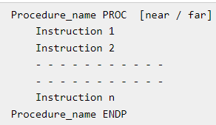
Procedures in the 8086 microprocessor
In a program, we very frequently face situations where there is a need to perform the same set of task again and again.
So, for that instead of writing the same sequence of instructions, again and again, they are written separately in a subprogram. This subprogram is called a procedure.
With the help of procedures, we can very well implement the concept of modular programming in our code.
Also, whenever we need to execute the instructions mentioned in the procedure, we can simply make a CALL to it.
Therefore, with the help of procedures, the duplicity in the instructions can be avoided.
The Syntax for a procedure is as follows:

Slide 70
The PROC is a keyword to define that the set of instructions enclosed by the given name is a procedure.
It is used in the starting instruction whenever we define a procedure.
The ENDP keyword defines that the body of the procedure has been ended.
All the instructions lying between these two keywords are the instructions that belong to the procedure and will be executed whenever a CALL to the procedure is made.
The keyword near or far defines the range of code within which the procedure is defined.
If it is defined in the same segment as the rest code, then near is used. If it is defined in some other segment, then the keyword far is used for it.
The CALL to a procedure can be made in the following way,
CALL procedure_name
At the end of the procedure, the RET instruction is used. This instruction will cause the execution to be transferred to the program from which the call to the procedure was made.

Slide 71
Macros in the 8086 Microprocessor
A Macro is a set of instructions grouped under a single unit. It is another method for implementing modular programming in the 8086 microprocessors (The first one was using Procedures).
The Macro is different from the Procedure in a way that unlike calling and returning the control as in procedures, the processor generates the code in the program every time whenever and wherever a call to the Macro is made.
A Macro can be defined in a program using the following assembler directives: MACRO (used after the name of Macro before starting the body of the Macro) and ENDM (at the end of the Macro). All the instructions that belong to the Macro lie within these two assembler directives. The following is the syntax for defining a Macro in the 8086 Microprocessor:
Macro_name MACRO [ list of parameters ]
Instruction 1
Instruction 2
- - - - - - - - - - -
- - - - - - - - - - -
- - - - - - - - - - -
Instruction n
ENDM
And a call to Macro is made just by mentioning the name of the Macro:
Macro_name [ list of parameters]

Slide 72
Example
Following example shows defining and using macros −
; A macro with two parameters
; Implements the write system call
%macro write_string 2
mov eax, 4
mov ebx, 1
mov ecx, %1
mov edx, %2
int 80h
%endmacro
section .text
global _start ;must be declared for using gcc
_start: ;tell linker entry point
write_string msg1, len1
write_string msg2, len2
write_string msg3, len3
mov eax,1 ;system call number (sys_exit)
int 0x80 ;call kernel
section .data
msg1 db 'Hello, programmers!',0xA,0xD
len1 equ $ - msg1
msg2 db 'Welcome to the world of,', 0xA,0xD
len2 equ $- msg2
msg3 db 'Linux assembly programming! '
len3 equ $- msg3
When the above code is compiled and executed, it produces the following result −
Hello, programmers! Welcome to the world of, Linux assembly programming!

Slide 73
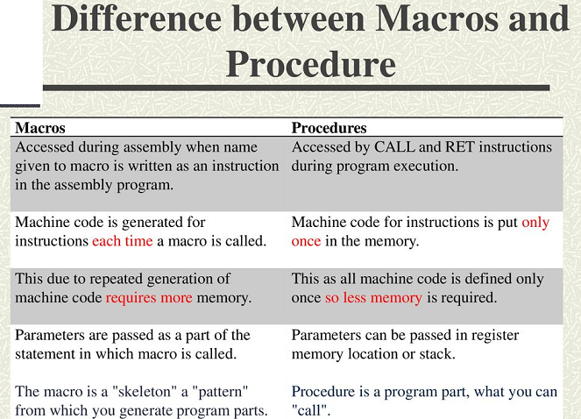

Slide 74


74

